Slide 1
LCME Update: Continuous Quality Improvement (CQI)

Slide 2
Today’s Panelists
Donna Waechter, PhD, LCME Assistant Secretary,
John Tomkowiak, MD, MOL, Dean, Chicago Medical School
Gary Giacomelli, MPA, Assistant Provost, Institutional Planning and Management Information, Southern Illinois University School of Medicine

Slide 3
Continuous Quality Improvement The Process
Schools are asking what CQI process satisfies Element 1.1
The LCME Subcommittee on Standards - initial discussion of guidance to provide to schools
Consideration of core accreditation elements and possible guidance about process

Slide 4
Continuous Quality Improvement Elements
1.1 Strategic Planning and Continuous Quality Improvement
1.5 Bylaws
3.3 Diversity/Pipeline Programs and Partnerships
3.5 Learning Environment/Professionalism
3.6 Student Mistreatment
4.4 Feedback to Faculty
4.5 Faculty Professional Development

Slide 5
Continuous Quality Improvement Elements
5.1 Adequacy of Financial Resources
6.2 Required Clinical Experiences
6.3 Self-Directed and Life-Long Learning
8.1 Curricular Management
8.2 Use of Medical Educational Program Objectives
8.3 Curricular Design, Review, Revision/Content Monitoring
8.4 Program Evaluation

Slide 6
Continuous Quality Improvement Elements
8.5 Use of Student Evaluation Data in Program Improvement
8.6 Monitoring of Completion of Required Clinical Experiences
8.7 Comparability of Education/Assessment
8.8 Monitoring Student Workload
9.1 Preparation of Resident and Non-Faculty Instructors
9.4 Variety of Measures of Student Achievement/Direct
Observation of Core Clinical Skills
12.1 Financial Aid/Debt Management Counseling/Student Educational Debt

Slide 7
Continuous Quality Improvement White Paper
Possible LCME white paper on CQI
Core CQI processes
Tailoring CQI to the needs of the medical school
CQI-related organizational and staffing requirements

Slide 8
Standards Based Continuous Quality Leadership (SBCQL)
An Approach to Achieving Excellence in Medical Education at Chicago Medical School
John Tomkowiak MD, MOL
James Zimmerman BSNE

Slide 9
“Quality, Patient Safety and Patient Satisfaction are the new Currency in Healthcare Delivery”

Slide 10
CMS Case for Action
Strategic planning not connected to standards
On probation twice in last 10-years
Outdated curriculum leading to below norm education outcomes
GQ data indicates weaknesses in several areas with declining trends
Culture of complacency inhibiting action
High number of recently unmatched students

Slide 11
Quality Now a Prospective Requirement
LCME Standard Element 1.1
A medical school engages in ongoing planning and continuous quality improvement processes that establish short and long-term programmatic goals, result in the achievement of measurable outcomes that are used to improve programmatic quality, and ensure effective monitoring of the medical education program’s compliance with accreditation standards.

Slide 12
Standards Based Continuous Quality Leadership (SBCQL) Program Objective
With our Medical Students and clinical patients as our core customers;
Build a lasting infrastructure of human talent, information technology and continuous quality improvement processes that work together to achieve excellence in medical education and patient care

Slide 13
SBCQL Program Goals
Real time compliance status and performance trends
Identification of opportunities to achieve excellence at reasonable cost
Adverse trends always addressed using CQI methods Model for Improvement, LEAN, Six Sigma, etc.
DCI documents always current and available
LCME ASSET database always current

Slide 14
Office of Accreditation
CMS Office of Accreditation
LCME
HLC
ACGME
IBHE
Illinois Board of Higher Education
Higher Learning Commission

Slide 15
SBCQL Leadership Teams
Faculty Leader
Faculty
Community Partners
Staff
Students

Slide 16
SBCQL Document Structure
DCI
Prepared by SBCQL Team
Updated Quarterly
CQL Specification
Elements
Benchmarks Compliance / Excellence
Standard Element Dashboard
Internet / Intranet Web Site
Compliance Status
Measures

Slide 17
Information Architecture
Standards
Elements
Measures
Measurements
Analyses and Actions

Slide 18
CQL Improvement Cycle for Each Standard Element
Element
AIM Statement
Specify Measures
Define Compliance
Define Excellence
Measurement & Analysis
PDSA-Plan, Do, Study, Act

Slide 19
Compliance versus Excellence?
SOC = Standard of Compliance
SOE = Standard of Excellence
8.7: Comparability of Education/Assessment
A medical school ensures that the medical curriculum includes comparable educational experiences and equivalent methods of assessment across all locations within a given course and clerkship to ensure that all medical students achieve the same medical education program objectives.
Measure: Variation between student satisfaction ratings across all clinical sites
SOC: Less than 20% variance
SOE: Less than 10% variance

Slide 20
Compliance versus Excellence?
SOC = Standard of Compliance
SOE = Standard of Excellence
11.1: Academic Advising
A medical school has an effective system of academic advising in place for students that integrates the efforts of faculty members, course and clerkship directors, and student affairs staff with its counseling and tutorial services and ensures that medical students can obtain academic counseling from individuals who have no role in making assessment or promotion decisions about them.
Measure: Academic Counseling mean satisfaction rate (on a scale of 1-5)
SOC: Within +/- 0.2 points of national mean
SOE: More than 0.2 points above national mean

Slide 21
Standards Based Continuous Quality Leadership Process
Initial CQL Spec
Standards Leadership Teams
Initial DCI
DCI Development and Update Process
LCME Asset
Update DCI
CQL Specification Process
Update CQL Spec / Implement CQI
CQL / CQI Project
Process
Measures, Goals and Alerts
LEAN,
Six Sigma,
Model for Improvement
Periodic Evaluation and Scoring Process
Information Collection Process
Business Intelligence Data Warehouse
Web Dashboard & Publishing Process

Slide 22
Case study – student Mental Health counseling services
MS-27 – Element 12.4 Student Access to Healthcare Services

Slide 23
Problem Overview
In 2014 the student rating of mental health services dropped significantly 3.9 to 3.3 and was well below the all schools mean rating of 4.0
This was an area of concern for the LCME in their evaluation of compliance with Standard MS-27, Element 12.4
Special surveys done by the Health System indicated areas of concern in the mental health service

Slide 24
Standard 12: Medical Student Health Services Dashboard
E3
Personal Counseling Mean Satisfaction Rating
E4
Student Mental Health Services Mean Satisfaction Rating
SOC = within +/- 0.2 points of national average SOE = more than 0.2 points above national average
Compliance Status =
SOC = within +/- 0.2 points of national average SOE = more than 0.2 points above national average
Compliance Status =
E3
Student Well-Being Programs Mean Satisfaction Rating
E4
Student Health Services Mean Satisfaction Rating
SOC = within +/- 0.2 points of national average SOE = more than 0.2 points above national average
Compliance Status =
SOC = within +/- 0.2 points of national average SOE = more than 0.2 points above national average
Compliance Status =
Chicago Medical School:
Ensures that providers of student health services have no involvement in the academic assessment or promotion of students.
Provides all students with access to health insurance and disability insurance.
Follows accepted guidelines in determining immunization requirements for students.
Has policies in place to address student exposure to infectious and environmental hazards.
E5
E6
E7
E8

Slide 25
Improvement Team Established
Practice Manager
Provider Team
Student Leaders
Clinic Staff
Student Affairs

Slide 26
(IHI)* Model for Improvement
Aim Statement
What: Improve student satisfaction with mental health counseling services
How good: Increase CMS student mean rating as measured by GQ survey to above the mean for all schools
By when: End of academic year 2014/2015
* IHI Institute for Healthcare Improvement

Slide 27
Driver Diagram
Primary Drivers
Secondary Drivers
Ease of Access
Locations, Days Times of service
AIM
Improve Student Satisfaction with Counseling Services
Counselor Effectiveness
Counselor Experience
Need Based Programming
Student Surveys
On Campus Outreach
Frequency of Presentations
Front Desk Service
Customer Service Training
Measure : GQ Mean Rating for Mental Health Services
Goal: Exceed Mean Rating for All Schools by end of AY 2014,15
Patient Privacy
HIPAA Training
Priority Improvements

Slide 28
Actions
Replaced post doctoral candidate counselor with experienced LCSW (Licensed Clinical Social Worker)
Test measure: GQ and internal survey data
Increased service hours from 4 to 5-days per week
Created walk in hours each day of service
Developed on-campus outreach presentations to create awareness of services available

Slide 29
Outcome
GQ - student mental health services mean rating increased from 3.3 to 4.1 exceeding the all schools mean of 4.0.

Slide 30
Other PDSA Cycle Opportunities
Institute Saturday hours
Prototype Tele-psychology services for M3 and M4 students away from campus for clerkships at regional hospitals
Partner with another institution to provide mental health services to CMS students in Chicago closer to clinical rotations
Group programming targeted at specific student needs

Slide 31
So – where are WE?
Importance of Transparency in Compliance Reporting

Slide 32
Standards-Based Continuous Quality Leadership (CQL)
The determinations shown reflect self-assessments by the Chicago Medical School as a product of its continuing evaluation and process improvement efforts; as such, they are subject to change as circumstances and our assessments change. These determinations should not be interpreted as assessments of accreditation entities or other external bodies.
LCME STANDARDS DASHBOARD – Academic Year 2015-16 First Quarter
Link to site
Element | S T A N D A R D S
 | S1 | S2 | S3 | S4 | S5 | S6 | S7 | S8 | S9 | S10 | S11 | S12
1
2
3
4
5
6
7
8
9
10
11
12
Status Key:
= Achieved Excellence
= In Compliance
= In Compliance with Concern

Slide 34
In Conclusion
Continuous Quality Improvement is not an option – rather it is expected by the LCME
Establishing a culture of Continuous Quality Leadership is critical to long term success
Transparency in performance reporting is important to sustaining the culture
The technology platform to enable CQI is commonly available in our institutions
Implementing CQL + CQI leads to real improvement in medical school performance

Slide 35
Do It Again Only Better:
CQI Strategies for a Successful Accreditation Review
Gary J. Giacomelli
Assistant Provost, Institutional Planning
Southern Illinois University School of Medicine
Springfield, Illinois
November 12, 2015

Slide 36
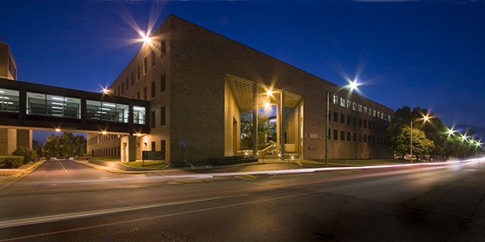
LCME Full, Citation-Free Accreditations
(2007, 2015)
Southern Illinois University
(SIU) School of Medicine

Slide 37
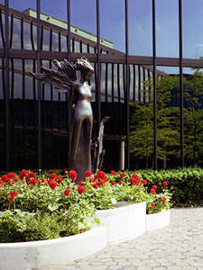
Obvious and Frequent Questions
How did you do it?
How did you do it … again?
How will you continue to do it?
Do It Again Only Better!

Slide 38
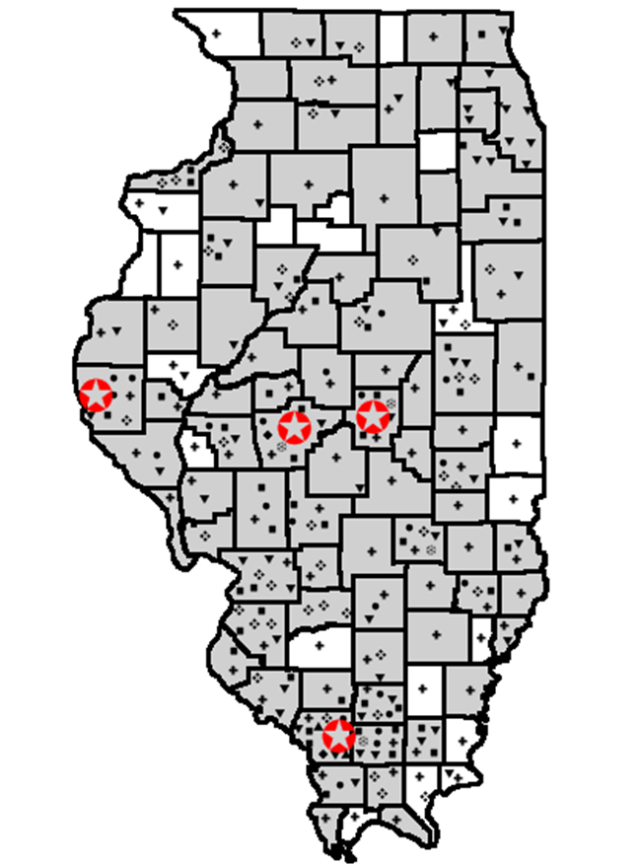
Southern Illinois University School of Medicine
The mission of the SIU School of Medicine is to assist the people of central and southern Illinois in meeting their health care needs through education, patient care, research, and service to the community.
Quincy
Springfield
Decatur
Carbondale

Slide 39
Southern Illinois University School of Medicine
Public community-based medical school
Established 1970
72 medical students per year; 288 total
350 residents and fellows
100+ graduate students; 75 PA students
116,000 patients; 540,000 visits
$100 million in clinical revenue
$35 million in active research funding
345 full-time faculty; 1800 employees

Slide 40
Mission Metrics
Graduates practicing in: (AAMC MMT, 2015)
Rural Areas: > 80th percentile
Primary Care: > 80th percentile
In Illinois: > 60th percentile
“Social Mission” medical school 2010
AMEE 3 Aspire Awards 2013
3 Hubbard Awards, 1 Flexner Award
LCME Full, Citation-Free Accreditations (2007, 2015)

Slide 41
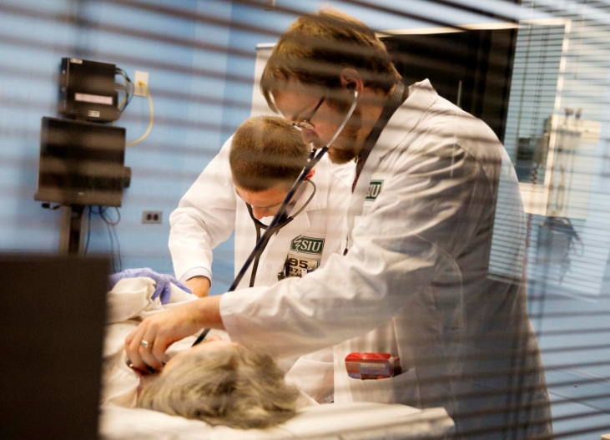
Advantages: Natural and Otherwise
Medical Education is Priority #1
Tradition of innovation, student-focus
Culture of continuous improvement
Leadership in education
Strong participation of students and faculty
Effective, experienced administrators
Supportive university, clinical affiliates, and community

Slide 42
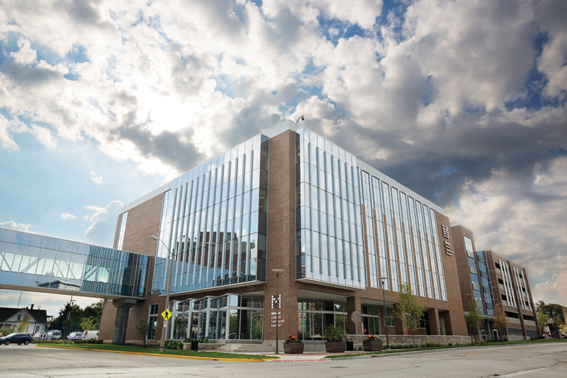
Advantages: Natural and Otherwise
Memorial Center for Learning and Innovation

Slide 43
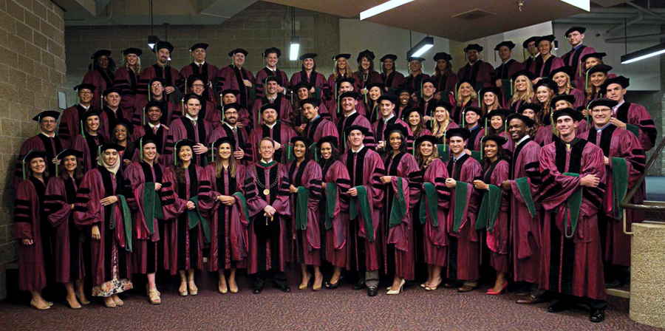
Advantages: Natural and Otherwise
Experienced accreditation core team
Deanly leadership

Slide 44
CQI Strategies
(How We Did It … and How We Did It Again)
1. Participation with LCME
Site visits
Webinars
Conferences
2. Dean’s staff standards reviews
Reviews of elements within standards (2x)
Dean’s staff … prepared/presented
Challenges/corrections

Slide 45
CQI Strategies
(How We Did It … and How We Did It Again)
Integration with planning and data analysis
Data analysis – early warning
Action planning – correction
Strategic/institutional planning – correction
Curriculum reviews/improvements
Faculty curriculum committees
Medical Education department faculty/staff
Monitor performance … identify problems … correct

Slide 46
CQI Strategies
(How We Plan on Continuing to Do It)
5. Continuous formal review of standards
Continuous review of LCME standards/elements
Gap analysis
Correction
6. Continuous formal review of DCI-data
Continuous monitoring of LCME DCI
Replication of selected DCI data
Gap analysis
Correction

Slide 47
CQI Strategy – Basic Approach
Plan
Identify benchmarks/expectations
Collect/analyze/assess data
Formulate correction
Integrate correction
Do It Again
Only Better
Act
Do
Test correction
Study
Monitor data
Assess impact/effect
W. Edwards Deming/Walter Shewhart

Slide 48
CQI Approach Going Forward
Challenges
Resource and budget pressures
Passing of the core team
Responses
Lean operation – no additional staff, no designated office
Continue to emphasize/support continuous improvement and innovation
Institutionalize CQI

Slide 49
Advice to Other Schools Preparing for LCME Review
Begin with the Commitment …
Set goal – full accreditation with no citations
Prepare the school (communicate, inculcate)
Perform rigorous and honest reviews
Identify problems and fix them

Slide 50
Advice to Other Schools Preparing for LCME Review
Commit to Success …
Organize project effectively
Project manage effectively – stick to schedule
Prepare DCI/self-study/everything from the perspective of the LCME site team and committee
Post mortem review of the effort – what worked, what did not work, notes for the future

Slide 51
In Short …
Make Medical Education Priority #1
Commit to improvement – adopt a CQI culture
Utilize your school’s advantages
Implement basic “Plan-Do-Study-Act” approach
Scope approach to match your culture, strengths, and resources
View LCME accreditation review as an opportunity
Do It Again Only Better!

Slide 52
For More Information – Contact:
Gary J. Giacomelli
Assistant Provost, Institutional Planning
Office of the Dean and Provost
Southern Illinois University
School of Medicine
801 N. Rutledge, PO Box 19620
Springfield, Illinois 62794-9620
217/545-1384
ggiacomelli@siumed.edu

Slide 53
SIUSOM_Giacomelli_AAMC_MedEd_Conf_Nov2015_110115.pptx

